Slide 1
UNIT-5 Part-I Pervasive Computing
By
Dr. K. Shahu Chatrapati
Professor & Controller of Examinations

Slide 2
1. Introduction
Influence of Science and Technology Erich Fromm notes that both market laws and technological advancements human life, underscoring the profound impact of scientific development.
Transformation of Work and Home Environments Personal computing and the Internet have revolutionized both office work and home life.
Introduction of Pervasive Computing Represents the next evolution of personal computing, promising significant enhancements in work environments, daily living, and communication with others.

Slide 3
Gradual Adoption of New Technologies Technologies like the Internet and pervasive computing gradually integrate into society, often starting with limited expert use before reaching the general public.
Current Technology Usage Trends The shift from traditional methods to modern technologies is evident with examples like the widespread use of mobile phones for messaging and digital cameras replacing film cameras, which also influence new business environments and communication styles.

Slide 4
We have discussed about
Erich Fromm highlights the profound impacts of market laws and technological advancements on human life.
Personal computing and the Internet have revolutionized work and home environments.
Pervasive computing represents the next step in personal computing, enhancing daily life and communication.
New technologies like the Internet begin with expert use and gradually reach the general public.
The shift to mobile phones and digital cameras illustrates modern technology's influence on business and communication.

Slide 5
2. Pervasive Computing Scenarios
2.1 Pervasive Computing in Automobiles
Modern luxury cars as examples of pervasive computing with integrated systems for personal settings, navigation, and safety.
Features include automatic adjustments based on user presence, environmental responsiveness like adaptive lighting and wipers, and advanced safety systems like automated emergency calls.
Future enhancements may include pothole detection and more coordinated system functionalities.

Slide 6
2.2 Integration of Devices in Automobiles
Seamless integration of devices such as car keys, mobile phones, and audio systems.
The use of multiple interfaces (e.g., touch screens, buttons) to enhance user experience.
Combination of offline and online systems ensuring continuous operation and connectivity.
2.3 Mobile Workplace Evolution
Transformation from traditional office setups to mobile workspaces with wireless connectivity for computers, phones, and other digital devices.
Increasing flexibility in work locations and hours, contributing to better work-life balance and reduced urban traffic issues.
Expansion in roles of mobile devices in manufacturing for process monitoring and in retail for service enhancement.

Slide 7
2.4 Pervasive Computing in Homes
Use of mobile phones, PCs, and entertainment devices to create interconnected home environments.
Integration of household devices through local networks, enhancing control over home management systems like lighting, security, and entertainment.
Slow adoption of integrated home systems due to challenges in standardizing diverse technologies.

Slide 8
We have discussed about
Pervasive Computing in Automobiles
Integration of Devices in Automobiles
Mobile Workplace Evolution
Pervasive Computing in Homes

Slide 9
3. The personal communication environment
3.1 Diversity of Devices and Services
People currently use a variety of devices (e.g., mobile phones, PCs, digital cameras) for communication, work, and entertainment.
These devices often operate independently and are not well integrated, complicating user interactions and service management.
3.2 Emergence of Integrated Systems
New systems are merging functionalities of multiple devices, such as controlling home systems via mobile phones or programming video recorders from PCs.
Integration challenges include locating responsible service providers and managing diverse user credentials.

Slide 10
3.3 Evolution of Personal Communication
The pervasive computing environment is evolving towards a unified communication landscape with shared security and access infrastructure.
Similar to the GSM environment, it allows for seamless service provision without requiring users to switch interfaces.
3.4 Flexible and Adaptive Communication Options
Users can temporarily switch communication paths or reroute them to different media, enhancing flexibility (e.g., routing SMS to a voice mailbox).
Adaptability to choose the most cost-effective communication route or receive immediate alerts for specific events.

Slide 11
3.5 Advancements in Mobile Technology
The third generation of mobile devices utilizing GPRS or UMTS supports sophisticated communication needs with packet-switched networks.
Defined quality-of-service options ensure reliable communication despite potential channel distortions, allowing users to remain connected without interruption based on actual data use.

Slide 12
We have discussed about
Diversity of Devices and Services
Emergence of Integrated Systems
Evolution of Personal Communication
Flexible and Adaptive Communication Options
Advancements in Mobile Technology

Slide 13
4. Location-based services
4.1 Functionality of Location-Based Services (LBS)
Utilize mobile systems to determine device location by measuring signal runtime between transmitters and the device.
Employ satellite-based GPS for high accuracy location tracking almost anywhere on Earth.
4.2 Challenges with GPS Technology
Environmental factors such as buildings, mountains, and heavy rainfall can disrupt GPS signals.
GSM systems may still function where GPS fails, providing an alternative means of location determination.

Slide 14
4.3 Emergency Services and LBS
Essential for handling emergency calls, where rapid location identification can save lives.
The U.S. government mandates emergency call location services to enhance public safety.
4.4 Applications Beyond Emergency Services
Enable diverse applications that link the Internet with the physical world, such as dynamic network roaming.
Support a wide range of services from navigation to real-time location-based marketing and social applications.
4.5 Privacy Concerns and User Control
Raises significant privacy issues, especially when tracking is done without clear consent.
Systems include functionalities for users to opt-out or suppress location tracking, akin to caller ID suppression in GSM networks.

Slide 15
We have discussed about
Functionality of Location-Based Services (LBS)
Challenges with GPS Technology
Emergency Services and LBS
Applications Beyond Emergency Services
Privacy Concerns and User Control

Slide 16
5. Roaming Environment
5.1 Multi-Device Usage
Advanced users employ various devices such as multimedia PCs, TVs, WAP phones, and PDAs for diverse tasks ranging from e-business to entertainment.
Devices are expected to offer personalized communication settings, enhancing user experience across different environments like cars and workspaces.
5.2 New Communication Patterns
Emergence of mobile communication patterns such as mobile chat, virtual blackboards, auctioning, games, multicast messaging, and collaboration.
These new forms cater to an increasingly mobile and digitally interconnected user base.

Slide 17
5.3 Ubiquitous Network Access
Access to the World Wide Web is facilitated by terrestrial wireless networks, satellite networks, and local area networks available in various settings including offices, shops, and homes as in below figure.
Pervasive computing devices support both online and offline peer-to-peer communication and wireless networking.
5.4 Seamless Data Synchronization
Users expect to roam across different mobile networks and devices with data and functions being synchronized transparently and without much intervention.

Slide 18
5.5 Security and Privacy
The roaming environment must ensure robust security and privacy protections to gain widespread acceptance.
The GSM Subscriber Identity Module (SIM) card provides a secure environment for user identification and is evolving to include additional security functions for various service providers.
5.6 Advancements in Security Infrastructure
Introduction of public key infrastructure in PC operating systems, secure web protocols, and legally endorsed digital signatures.
These technologies are crucial for building a secure, integrated system that merges internet and wireless communications for mobile e-business.

Slide 19
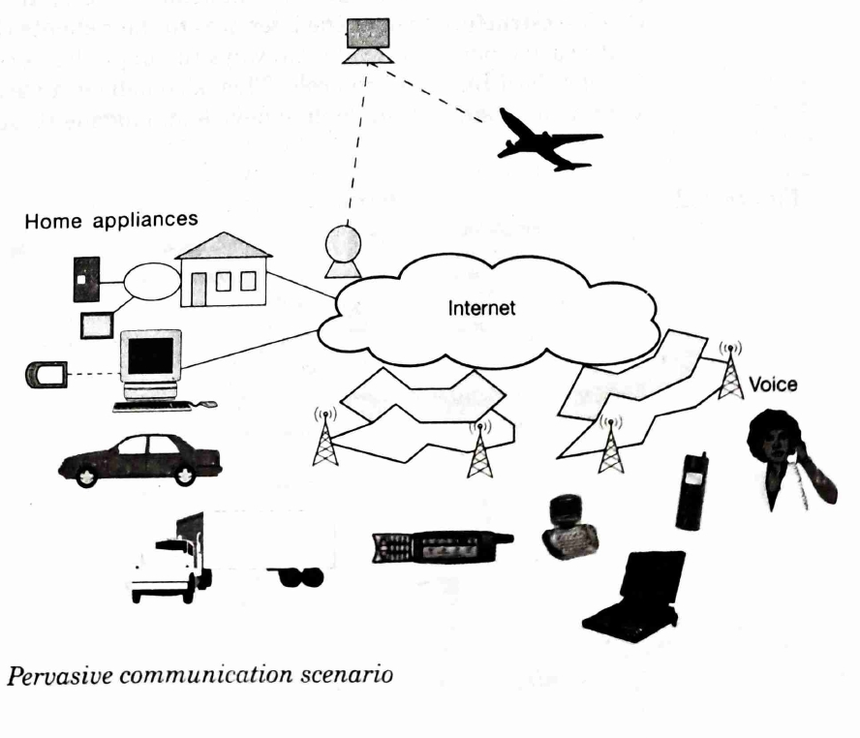

Slide 20
We have discussed about
Multi-Device Usage
New Communication Patterns
Ubiquitous Network Access
Seamless Data Synchronization
Security and Privacy
Advancements in Security Infrastructure

Slide 21
6.Pervasive computing infrastructure
6.1 Integration of Devices and Networks
Transition from isolated personal devices to an interconnected environment where devices, networks, and services such as PLMNs, PSTNs, and gateways are all interconnected.
Emphasis on integrating system management and billing systems to streamline operations across diverse technological platforms.
6.2 Role of Pervasive Portals
Pervasive portals serve as crucial gateways that adapt devices to standard internet protocols, facilitating personalization, mobile device management, security, and data synchronization as in below figure.
These portals ensure stable application interfaces amidst rapidly changing device features, enhancing user experience and system reliability.

Slide 22
6.3 Regulation and Market Dynamics
Historical context of tightly regulated telecommunications markets dominated by state-owned enterprises versus the current deregulated environment with multiple competing providers.
Current challenges include achieving interoperability and standardization critical for industry success, with ongoing efforts by industry committees to address these issues.
6.4 Technological Competition and Evolution
Two main technologies vying in the market GSM/UMTS and the i-mode system developed by NTT DoCoMo, each with distinct strengths such as widespread support and rich application sets, respectively.
Discussion on the adaptation challenges in different regions, with Europe and Asia favoring GSM/UMTS, and varied adoption rates in the Americas.

Slide 23
6.5 Advancements in Mobile Technology
Introduction of high-speed, packet-switched networks like GPRS and UMTS to overcome limitations of earlier WAP systems and support advanced 3G applications.
Evolution of pervasive computing devices to support higher computing power and multimode RF circuitry, accommodating multiple communication standards and protocols during transition periods.

Slide 24
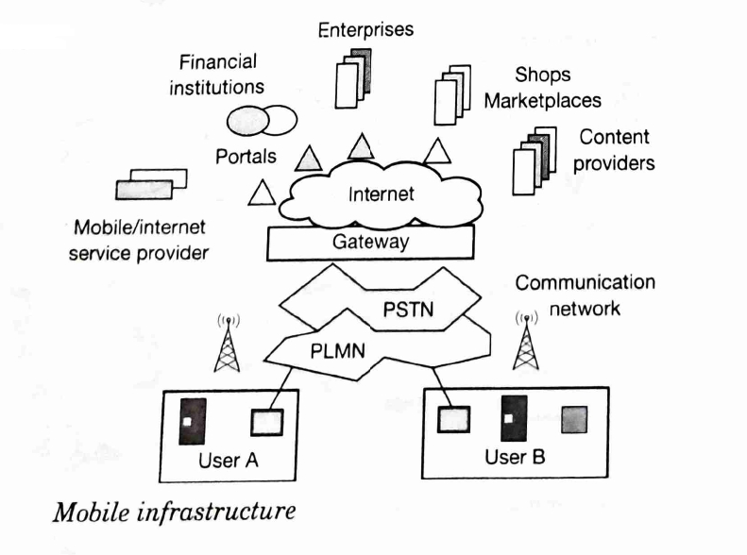

Slide 25
We have discussed about
Integration of Devices and Networks
Role of Pervasive Portals
Regulation and Market Dynamics
Technological Competition and Evolution
Advancements in Mobile Technology

Slide 26
7. Summary
Pervasive computing extends personal computing to enhance global communication and information access.
Automobiles feature advanced safety, navigation, and personalization technologies.
Workplaces transform into mobile and flexible environments with enhanced connectivity.
Homes integrate smart devices for better management and entertainment.
Communication evolves towards unified, seamless services across devices.
Integrated networks of devices and systems support robust data exchange and seamless operations.
Advanced mobile technologies like GSM/UMTS and i-mode support global roaming.
Future innovations focus on security, personalization, and management.
Critical emphasis on privacy and security to ensure user acceptance and data protection.
Mechanisms in place to control location visibility and secure data across platforms.

